Slide 1
3D Printing Parameter Optimisation: Impact of K-Value on Carbon-Reinforced PETG
Date: 08/09/2026
Vipul Kohinkar
40490839
MEE 7012 60 CATS
Individual Project and Dissertation

Slide 2
Presentation Structure
Nomenclature
Introduction
Project Aim and Objectives
Methodology: Materials & Manufacturing
Methodology: Testing & Analysis
Results: Strength & Stiffness
Results: Elongation
Discussion
Limitations & Future Work
Conclusions
References

Slide 3
Nomenclature
Term | Full Name
FDM | Fused Deposition Modelling
PETG | Polyethylene Terephthalate Glycol
CF-PETG | Carbon-Fibre-Reinforced PETG
K | Flow-Rate Multiplier
UTS | Ultimate Tensile Strength
E | Young's Modulus
p | p-value (statistical significance)
ANOVA | Analysis of Variance
Tukey HSD | Tukey Honestly Significant Difference
SEM | Scanning Electron Microscopy
ISO | International Organization for Standardization
MPa / GPa | Megapascal / Gigapascal
MJ/m³ | Megajoules per cubic metre

Slide 4
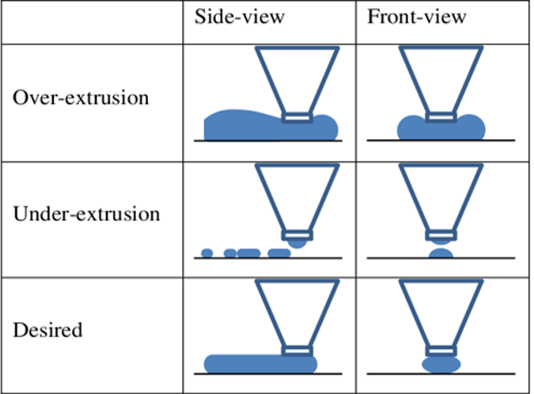
Introduction
Why investigate K-value?
K-value controls material deposition during FDM
K < 100% – Under-extrusion → potential gaps/discontinuities
K = 100% – Nominal deposition
K > 100% – Over-extrusion
→ potential dimensional
effects
Figure. 1 Extrusion states (Huang, 2018)

Slide 5
Project Aim
Aim
To determine how K-value and build orientation influence the tensile properties of PETG and CF-PETG, and whether the response differs between the unreinforced polymer and the fibre-reinforced composite.
Objectives
Review the literature on flow rate and build orientation in FDM to identify the research gap
Manufacture PETG and CF-PETG tensile specimens across four K conditions and two build orientations
Determine UTS, Young's modulus, elongation at break and toughness for each condition
Examine surface and fracture morphology using optical microscopy
Evaluate the combined effect of flow rate and build orientation on tensile performance

Slide 6
Methodology: Materials & Manufacturing
PETG vs 20% carbon-fibre-reinforced PETG (CARBON-P) – RS PRO filaments
Printed on Ultimaker S5 via Cura, material-specific nozzle sizes and temperatures.
Fixed parameters: 0.2mm layer height, 100% infill, 40mm/s (following Patel et al., 2024)
Design of Experiments:
Factor | Levels | Count
Material | PETG, CF-PETG | 2
K-Value | 80%, 90%, 100%, 110% | 4
Orientation | Flat, On-edge (Faidallah et al., 2023) | 2
Total conditions | 2 × 4 × 2 | 16

Slide 7
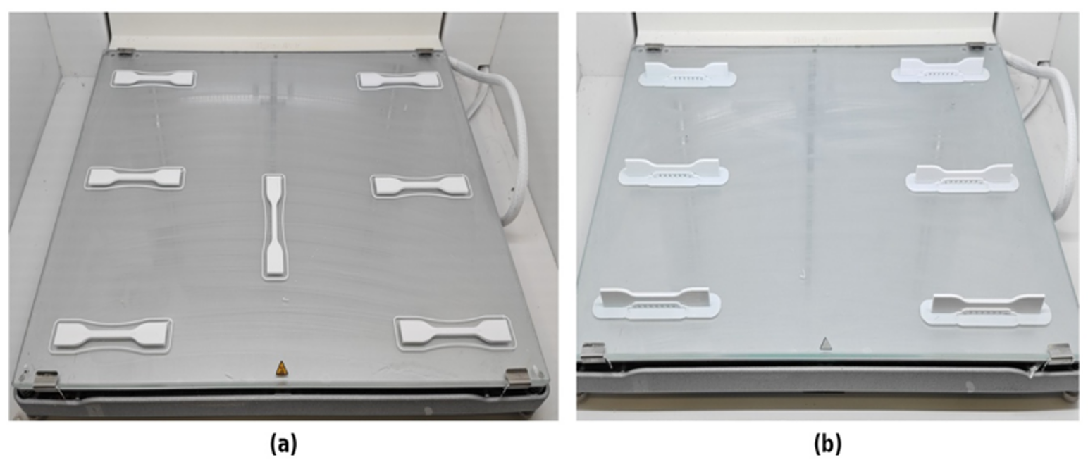
Figure. 2 Specimen batches printed in (a) flat orientation and (b) on-edge orientation.

Slide 8
Methodology: Testing & Analysis
Tensile Testing
Stage 1: Extensometer → Young's modulus (to 0.5% strain)
Stage 2: Crosshead → pull to failure
Data Processing
Measured dimensions → engineering stress-strain → E | UTS | Elongation | Toughness → Three-way ANOVA → Tukey HSD
Failure mode classified via 35.5% elongation threshold (k-means derived)
Microscopy
Optical microscopy (Nikon SMZ800) – surface and fracture morphology

Slide 9
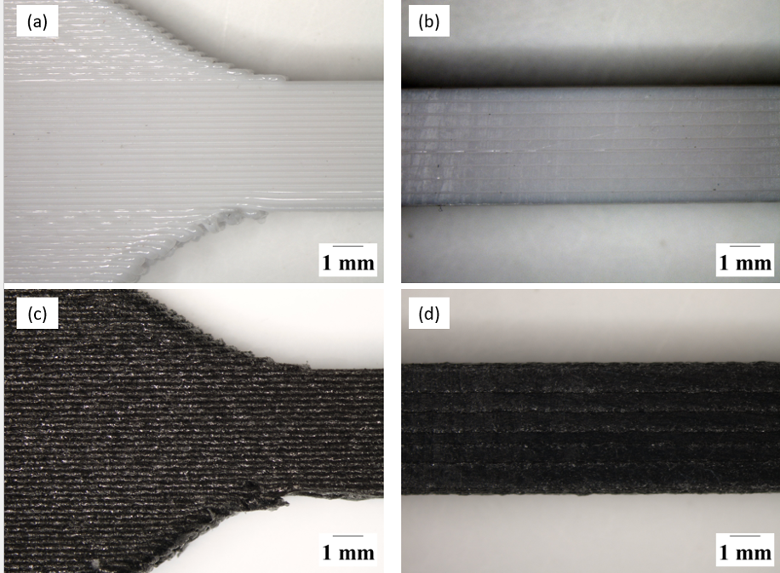
Figure. 3 Pre-test surface morphology – (a) PETG grip, (b) PETG gauge, (c) CF-PETG grip, (d) CF-PETG gauge

Slide 10
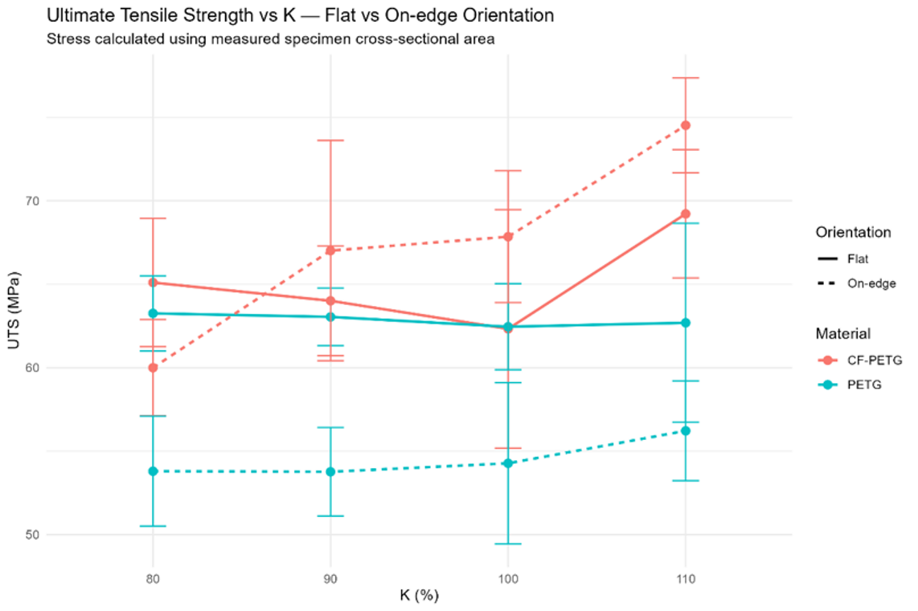
Results: Strength & Stiffness
Figure. 4 Mean UTS vs K– Flat vs On-edge

Slide 11
Results: Strength & Stiffness
CF-PETG: lowest at K=100% flat (~62 MPa), highest at K=110% on-edge (~75 MPa) – K110 significantly higher than K80/90/100 (all p<0.001)
PETG: stayed narrow (~62–63 MPa flat), no significant pairwise K differences
CF-PETG modulus roughly double PETG's (~4.6–6.0 GPa vs ~2.0–2.3 GPa), but barely shifted with K – K affects strength far more than stiffness

Slide 12
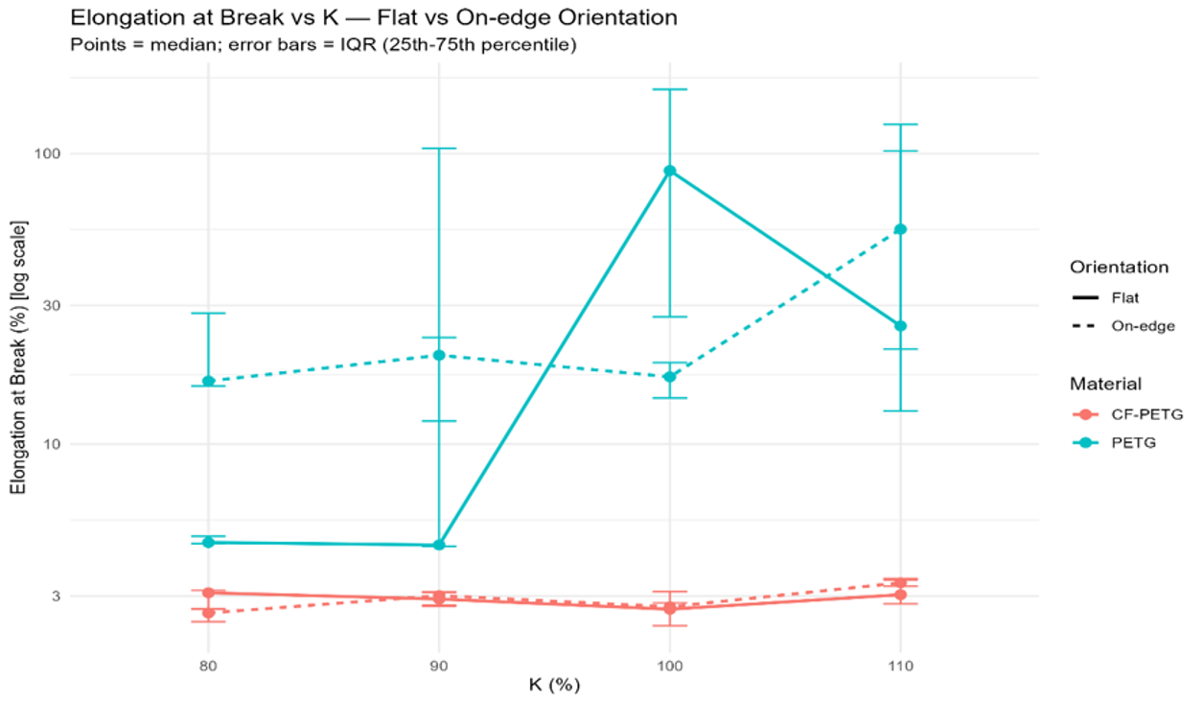
Results: Elongation
Figure. 5 Elongation at Break vs K– Flat vs On-edge

Slide 13
Results: Elongation
CF-PETG: consistently ~3% median elongation across all K-values and both orientations
PETG: highly variable – flat orientation stays low (~4%) at K=80/90, then jumps sharply to ~85% median at K=100, before dropping to ~25% at K=110
On-edge PETG stays more stable (~18–22%) before rising to ~45% at K=110
Elongation: Material p<0.001, Material × K × Orientation p=0.008

Slide 14
Discussion
K's effect is not universal – it depends on which material and which mechanical property you're looking at
For CF-PETG, higher flow likely improves how well adjacent extrusion paths bond, reducing the small gaps visible in this surface image – a plausible driver of the K110 strength increase
For PETG, K's influence shows up differently – not in strength, but in which failure mode a specimen ends up in, brittle or extensive drawing
Note: microscopy evidence is qualitative – it shows the irregularities exist, not that K caused them systematically

Slide 15
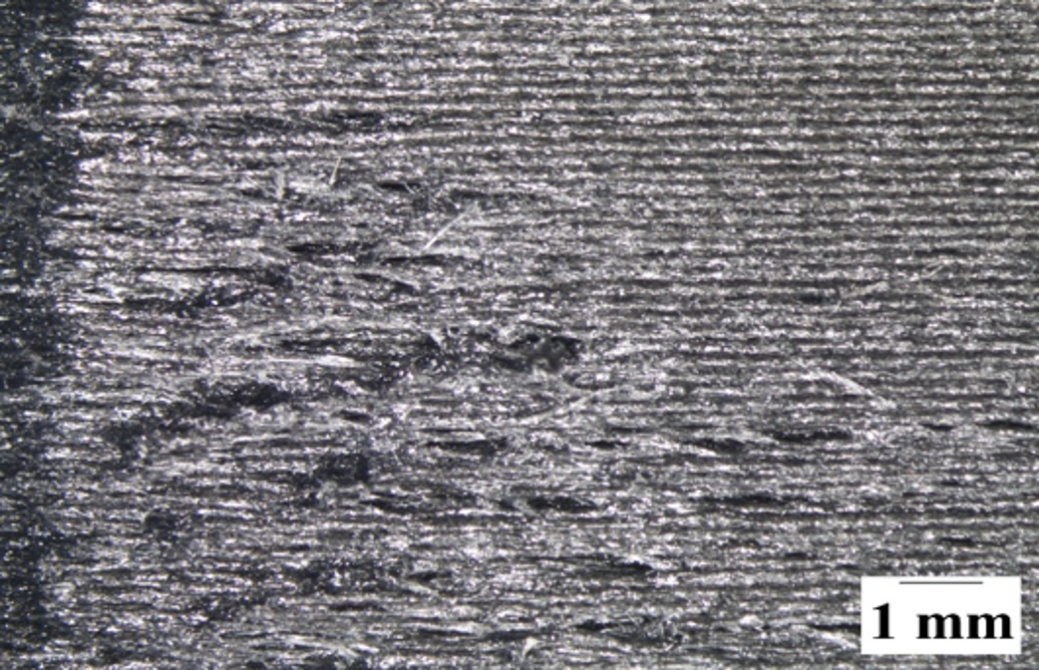
Figure. 6 CF-PETG surface showing local deposition irregularities.

Slide 16
Limitations & Future Work
Limitations:
Limited K range – only 80–110% investigated, limiting identification of a global optimum
Standardised tensile geometry – results may not transfer directly to complex components
Qualitative microscopy – defects could not be quantitatively measured or directly linked to K-value
Future Work:
Finer K sweep around high-performing conditions
Testing on complex, practical geometries
Quantitative defect analysis (SEM, porosity measurement)
Manufacturing efficiency: material, print time, and energy use

Slide 17
Conclusions
Literature review identified K as an underexplored parameter, particularly for reinforced composites – this project investigated that gap
80 specimens manufactured and tested across 16 conditions, evaluating UTS, modulus, elongation, toughness and fracture morphology
CF-PETG: substantially stiffer than PETG, clearest K-response in UTS – K=110% significantly higher than K=80/90/100% (p<0.001)
Orientation mattered differently by material – PETG weaker on-edge, CF-PETG stiffer on-edge
No universal "higher K = better" rule – K selection should be material- and property-specific

Slide 18
References
FAIDALLAH, R. F., HANON, M. M., VASHIST, V., HABIB, A., SZAKAL, Z. & OLDAL, I. 2023. Effect of Different Standard Geometry Shapes on the Tensile Properties of 3D-Printed Polymer. Polymers (Basel), 15.
HUANG, C. Y. 2018. Extrusion-based 3D Printing and Characterization of Edible Materials. Master of Applied Science, University of Waterloo.
PATEL, K. S., SHAH, D. B., JOSHI, S. J., ALDAWOOD, F. K. & KCHAOU, M. 2024. Effect of process parameters on the mechanical performance of FDM printed carbon fiber reinforced PETG. Journal of Materials Research and Technology, 30, 8006–8018.

